Slide 1
Interpreting Data
MCAS Practice
*Analyze the data given in each question. Choose the answer that is best supported by the data. Be ready to justify your thinking!
Click here for more MCAS Practice Released Items sorted by science category

Slide 2
https://www.youtube.com/watch?v=roZ-odEALS8

Slide 5
Constructed Response – 2 Slides

Slide 6
Constructed Response – 2 Slides

Slide 7
Constructed Response
Sample Student Work and Scoring Guide

Slide 10
Constructed Response – 2 Slides

Slide 11
Constructed Response – 2 Slides

Slide 14
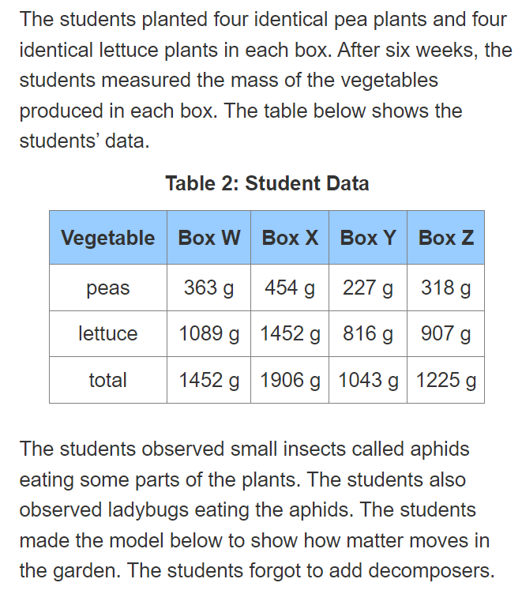
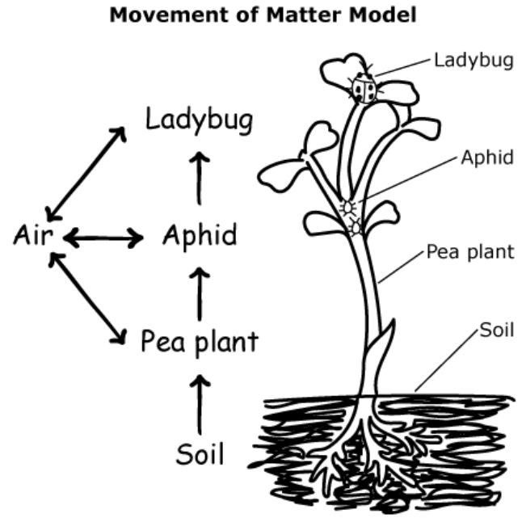
Constructed Response – 2 Slides

Slide 15
Sample Student Work and Scoring Guide

Slide 18
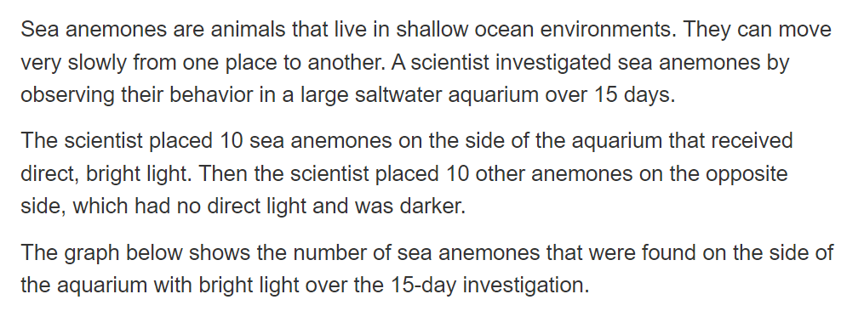
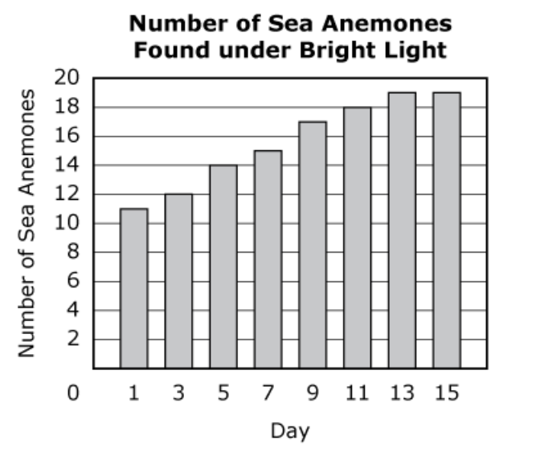

Slide 19
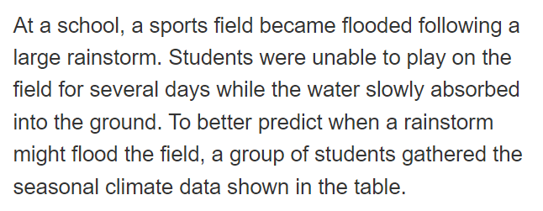
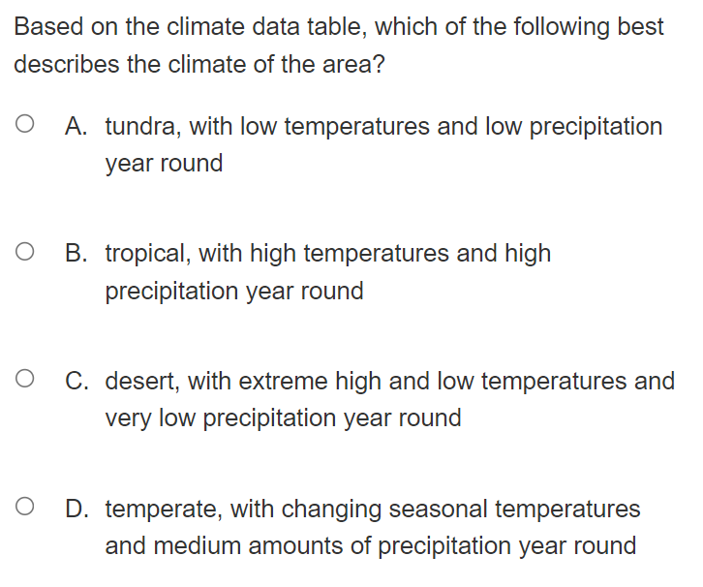
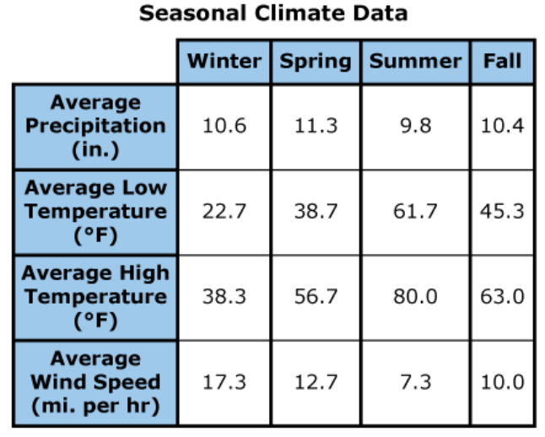
Sample Student Work and Scoring Guide

Slide 20
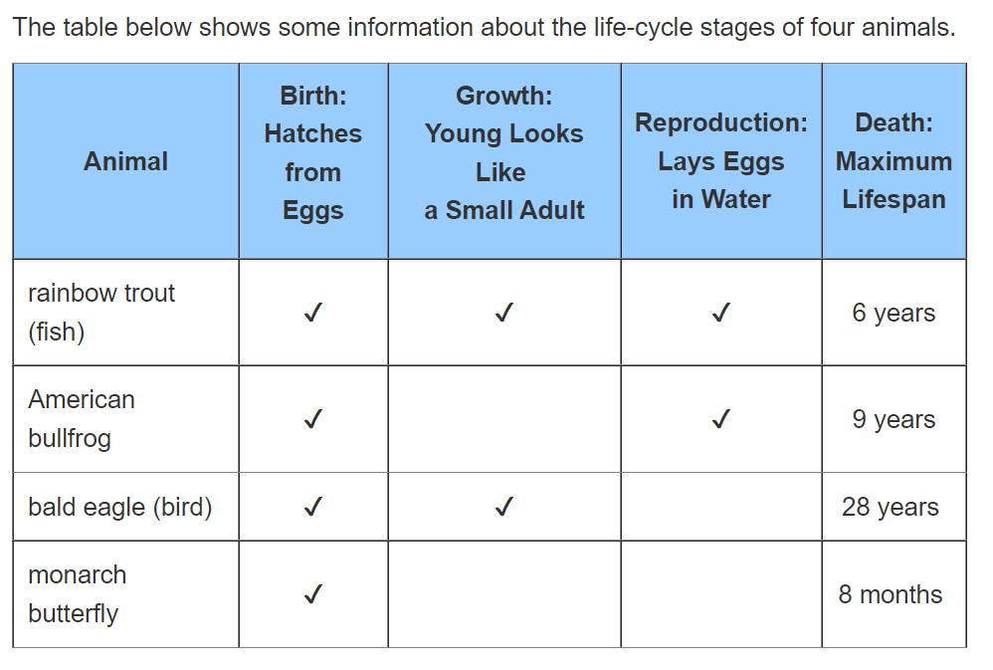
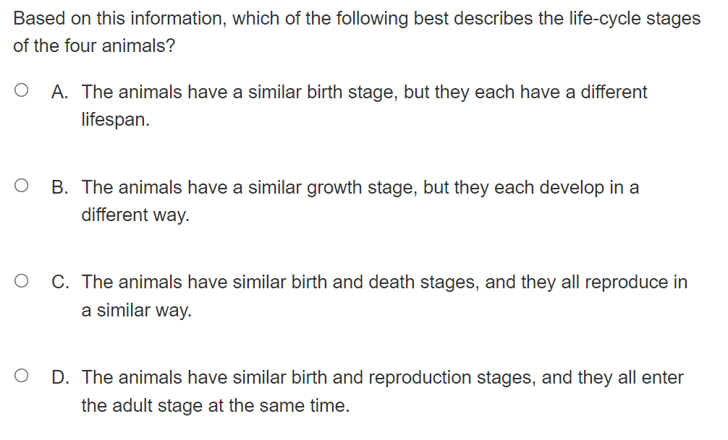

Slide 24
